Slide 1
NO REFERENCE UNDERWATER IMAGE QUALITY ENHANCEMENT USING ACTIVE INFERENCE FOR DEEP-SEA DEBRIS DETECTION
Team:
Abinaya.M.N(2018506004)
Divya Darshini.K(2018506029)
Kamalnath.K.N(2018506044)
Under the guidance of:
Dr. Radha Senthil Kumar

Slide 2
INTRODUCTION
No reference image quality assessment:
The goal of NR-IQA: predict the quality of an image as perceived by human observers(subjective perception)without the need of perfect undistorted source images.
GAN model used
Underwater images quality enhancement
Different from natural images, underwater optical images suffer from poor visibility due to the medium, which causes scattering and absorption of light so image quality is affected.
In water, image quality tends to be impaired by water density, light attenuation and scattering effect
Deep-sea Debris detection:
Ocean contamination causing marine life degradation
IPCC 2021 highlights immediate need for ecosystem preservation/monitoring

Slide 3
BASE PAPER
"Blind Image Quality Assessment With Active Inference“- Jupo Ma, Jinjian Wu, Leida Li; Weisheng Dong, Xuemei Xie, Guangming Shi, Weisi Lin, IEEE Transactions on Image Processing, 2021, Journal Article
Methodology:
Implemented an active inference module based on the generative adversarial network (GAN) to predict
the primary content in which the semantic similarity and the structural dissimilarity are both considered
during the optimization.
With the help of primary content obtained and the comprehensive quality degradation measurement from the multi-
stream CNN, their method achieves competitive performance on five popular IQA databases
Dataset:
Cross-database like LIVE, CSIQ, TID2013, LIVE-MD, LIVE-CH
Advantages:
WGAN-GP is adopted to stabilize the adversarial training.
Multi-stream CNN-based quality evaluator which can measure image quality from multiple aspects is proposed.
Limitations:
NR IQA has been done, enhancement step remains
Technique applied on images taken only in air medium

Slide 4
LITERATURE SURVEY
"Blind Image Quality Assessment of Natural Distorted Image Based on Generative Adversarial Networks“ Hongtao Yang, Ping Shi, Dixiu Zhong, Da Pan, Zefeng Ying, IEEE Access, 2019, Journal Article
Methodology:
Proposed a blind image quality assessment based on generative adversarial network (BIQA-GAN) with its advantages of self-generating samples and self-feedback training to improve network performance.
Three different BIQA-GAN models are designed according to the target domain of the generator
Dataset:
Live Challenge database
Advantages:
Natural distorted images are authentically distorted images, this is the first time that GAN related method applied to the natural distorted image quality assessment
Limitations:
Other efficient GANs have came to exist

Slide 5
LITERATURE SURVEY
“An Underwater Image Enhancement Algorithm Based on Generative Adversarial Network and Natural Image Quality Evaluation Index”-Kai Hu, Yanwen Zhang, Chenghang Weng, Pengsheng Wang, Zhiliang Deng and Yunping Liu, 2021, Journal of Marine Science and Engineering
Methodology:
This paper proposes to add the natural image quality evaluation (NIQE) index to GAN to provide generated images with higher contrast and make them more in line with the perception of the human eye, and at the same time, grant generated images a better effect than the truth images set by the existing dataset
Dataset:
EUVP dataset.
Advantages:
The real-time performance of the algorithm was analyzed to verify that the algorithm could be used in engineering.
Limitations:
Standard GAN is used

Slide 6
LITERATURE SURVEY
“Robotic Detection of Marine Litter Using Deep Visual Detection Models”-Michael Fulton1, Jungseok Hong2, Md Jahidul Islam3, Junaed Sattar, 2019, International Conference on Robotics and Automation (ICRA)
Methodology:
In this paper, they examine the problem of detecting debris, particularly plastic debris, in an underwater environment
Dataset:
J-EDI dataset
Advantages:
In this paper, they applied and evaluated four deep-learning based object detectors to the problem of finding marine debris, particularly plastic.
Have created unique comprehensive marine plastic database and kept it public/open-source for research purposes
Limitations:
Image quality assessment and enhancement were not considered in their scope
YOLOv2 has been used although significant improvements have been done in YOLO models now

Slide 7
LITERATURE SURVEY
“Deep-Sea Debris Identification Using Deep Convolutional Neural Networks”-Bing Xue, Baoxiang Huang, Ge Chen, Haitao Li, Weibo Wei, 2021,Ieee Journal Of Selected Topics In Applied Earth Observations And Remote Sensing, Journal Article
Methodology:
This study is to determine whether deep convolutional neural networks can distinguish the differences of debris and natural deep-sea environment
Dataset:
DDI dataset
Advantages:
Five common convolutional neural networks (CNNs) frameworks are also employed to implement the classification process
Limitations:
Image quality assessment and enhancement are not considered

Slide 8
RESEARCH GAP IDENTIFIED
Primary Content detection using Active Inference(IGM constraints)
were not applied on images obtained in water/underwater medium
which presents different challenges as opposed to air medium images
After performing Image quality assessment using GAN+CNN, Image quality enhancement step was lacking.

Slide 9
MOTIVATION OF THE PROJECT
Immediate need for solutions to environmental problems→IPCC 2021 REPORT
Ocean contamination causing marine life degradation
Marine life ingesting microplastic debris
No reference IQA is efficient
Implementing Active inference→primary content→makes assessment and enhancement efficient+easier.

Slide 10
APPLICATION OF THE PROJECT
Assessment of image quality+enhancement gives possibility of better detection, especially in light-distorted images captured in deep-sea/water mediums, that present high light scattering and high light absorption.
Marine/Deep-sea debris detection aids automated underwater systems in extracting such debris from depths, which is one of the needs of the hour as highlighted by scientific reports that have announced “code-red” for humanity.

Slide 11
PROBLEM STATEMENT
To assess and enhance the quality of underwater images using Active Inference technique employed using a GAN-CNN-GAN sandwich model
To detect deep-sea/marine debris upon enhancement using deep-learning

Slide 12
SCOPE OF THE PROJECT
In light-distorted images captured in deep-sea/water mediums, that present high light scattering and high light absorption, assessment of image quality & enhancement gives possibility of better debris detection.
Marine/Deep-sea debris detection aids Automated Underwater Vehicular Systems(AUV) in debris removal, which is of urgent environmental importance as presented in global sustainable models

Slide 13
PROPOSED WORK
Generative Adversarial Network→ Applying Active Inference technique to generate Primary Content on Underwater images
Multi-Stream CNN→ Quality evaluation is done based on primary content generated. Quality scores are outputted.
Generative Adversarial Networks→ Upon receiving quality scores, images are appropriately enhanced.
Marine/Deep-Sea Debris Detection→ On this newly enhanced image, we perform debris detection using deep learning techniques.

Slide 14
KEY TERMS
W-GAN GP→improvement on GAN(GAN was developed in 2014)
Primary Content Constraints:
Structural dissimilarity
Semantic Similarity
UEGAN→Image quality enhancement GAN technique

Slide 15
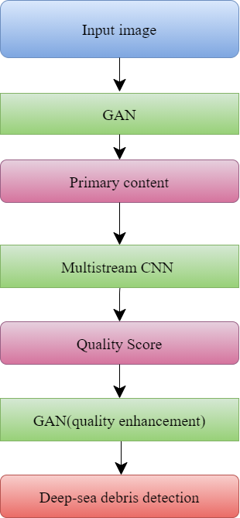
ARCHITECTURE DIAGRAM OF PROPOSED WORK

Slide 16
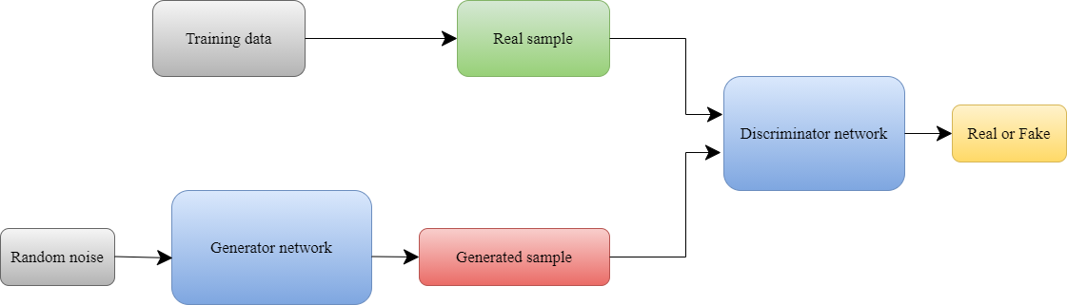
ARCHITECTURE DIAGRAM-GAN

Slide 17
HARDWARE AND SOFTWARE REQUIREMENTS
Hardware:
Intel i5 processor or higher.
8 GB RAM or higher.
Software/Tools:
Windows 10 or higher
Python 3.5.x or higher
Google Colab/Kaggle Jupyter notebook
TensorFlow 2.0
Pytorch
NumPy Stack (NumPy, Pandas, SciPy, Matplotlib)

Slide 18
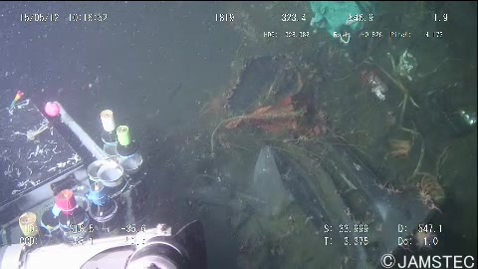
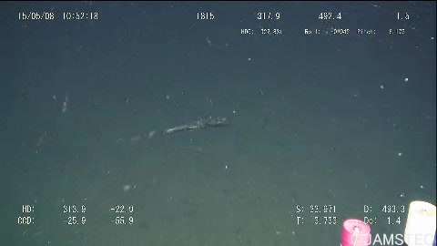
DATASET
TrashCan 1.0 An Instance-Segmentation Labeled Dataset of Trash

Slide 19
EXPECTED OUTCOMES/RESULTS
Image Assessment and Enhancement Sandwich Model
Assessment and enhancement of underwater image quality using Active Inference
Deep-Sea Debris Detection Model
Detection of deep-sea marine debris on newly enhanced image.

Slide 20
TENTATIVE WORK PLAN
S.No | Review | Work Plan
1 | First Review | Obtaining dataset Preliminary Outputs
2 | Second Review | Training the GAN Model to obtain the Primary content
3 | Third Review | Image quality assessment of underwater images Finding the quality score using multi-stream CNN

Slide 21
WORK TO BE CONTINUED
Enhancing the image quality using GAN
Deep sea debris detection

Slide 22
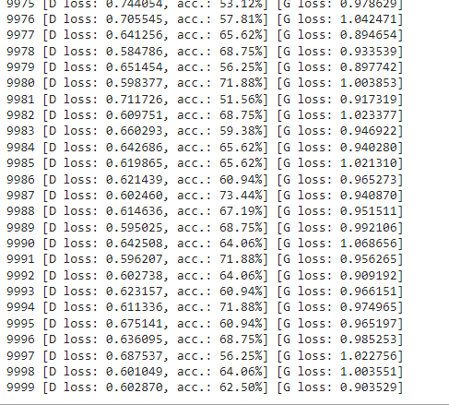
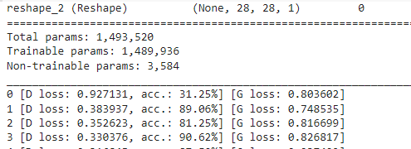
PRELIMINARY RESULTS/OUTCOMES
Comparative results for Standard GAN vs WGAN
GAN:

Slide 23
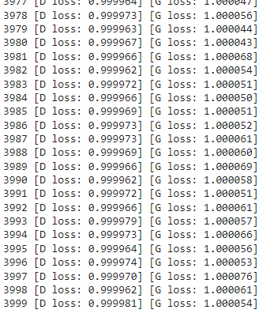
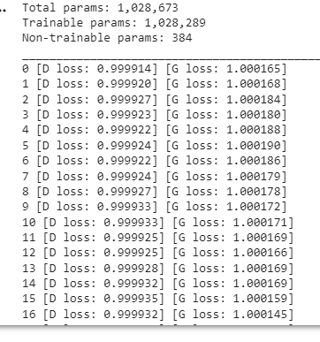
WGAN

Slide 24
REFERENCES
[1] "Blind Image Quality Assessment With Active Inference“- Jupo Ma, Jinjian Wu, Leida Li; Weisheng Dong, Xuemei Xie, Guangming Shi, Weisi Lin IEEE Transactions on Image Processing, 2021, Journal Article
[2] "Blind Image Quality Assessment of Natural Distorted Image Based on Generative Adversarial Networks“ Hongtao Yang,Ping Shi,Dixiu Zhong,Da Pan,Zefeng Ying,IEEE Access,2019,Journal Article
[3] “An Underwater Image Enhancement Algorithm Based on Generative Adversarial Network and Natural Image Quality Evaluation Index”-Kai Hu , Yanwen Zhang, Chenghang Weng, Pengsheng Wang , Zhiliang Deng and Yunping Liu,2021,Journal of Marine Science and Engineering
[4] “Robotic Detection of Marine Litter Using Deep Visual Detection Models”-Michael Fulton1, Jungseok Hong2, Md Jahidul Islam3, Junaed Sattar, 2019, International Conference on Robotics and Automation (ICRA)
[5] “Deep-Sea Debris Identification Using Deep Convolutional Neural Networks”-Bing Xue, Baoxiang Huang, Ge Chen, Haitao Li, Weibo Wei, 2021,Ieee Journal Of Selected Topics In Applied Earth Observations And Remote Sensing, Journal Article

Slide 25
THANK YOU

